Slide 1


NanoTag: Systems Support for Efficient Byte-Granular Overflow Detection on ARM MTE
Mingkai Li, Hang Ye, Joseph Devietti, Suman Jana, Tanvir Ahmed Khan
{mingkai.li, hy2891}@columbia.edu, devietti@cis.upenn.edu, suman@cs.columbia.edu, tk3070@columbia.edu
Columbia University University of Pennsylvania

Slide 2
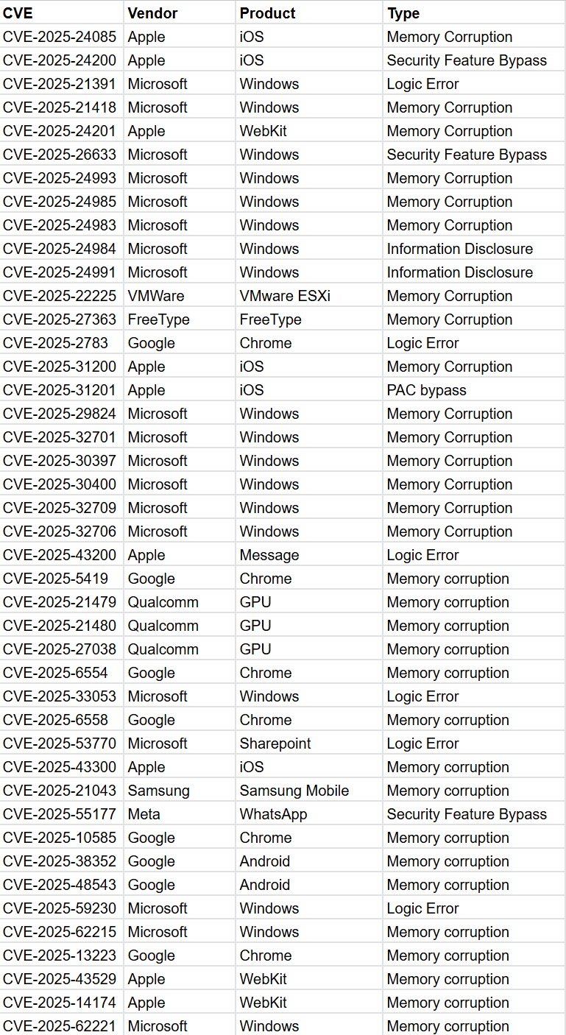
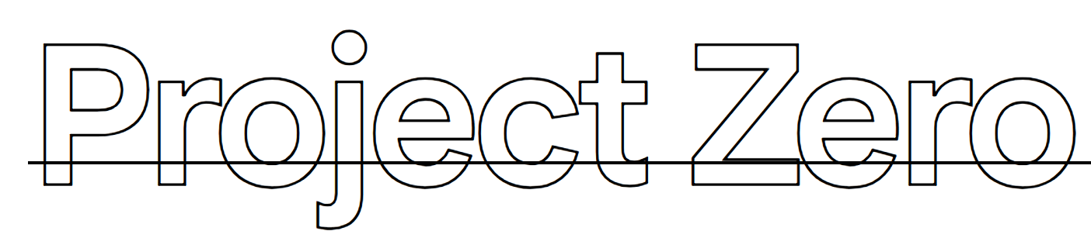
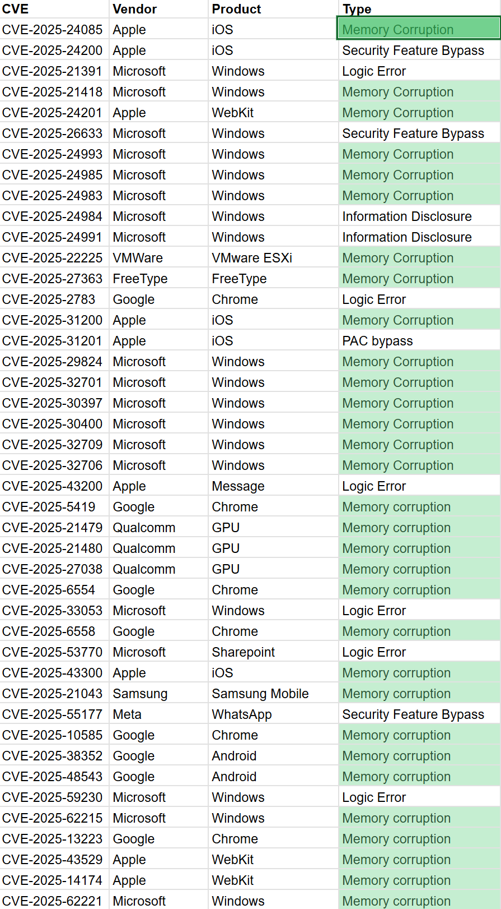







Memory Safety Issues Remain Dominant
Even in 2025, 31/43 (72%)
of in-the-wild 0-day exploits were memory safety issues.

Slide 3

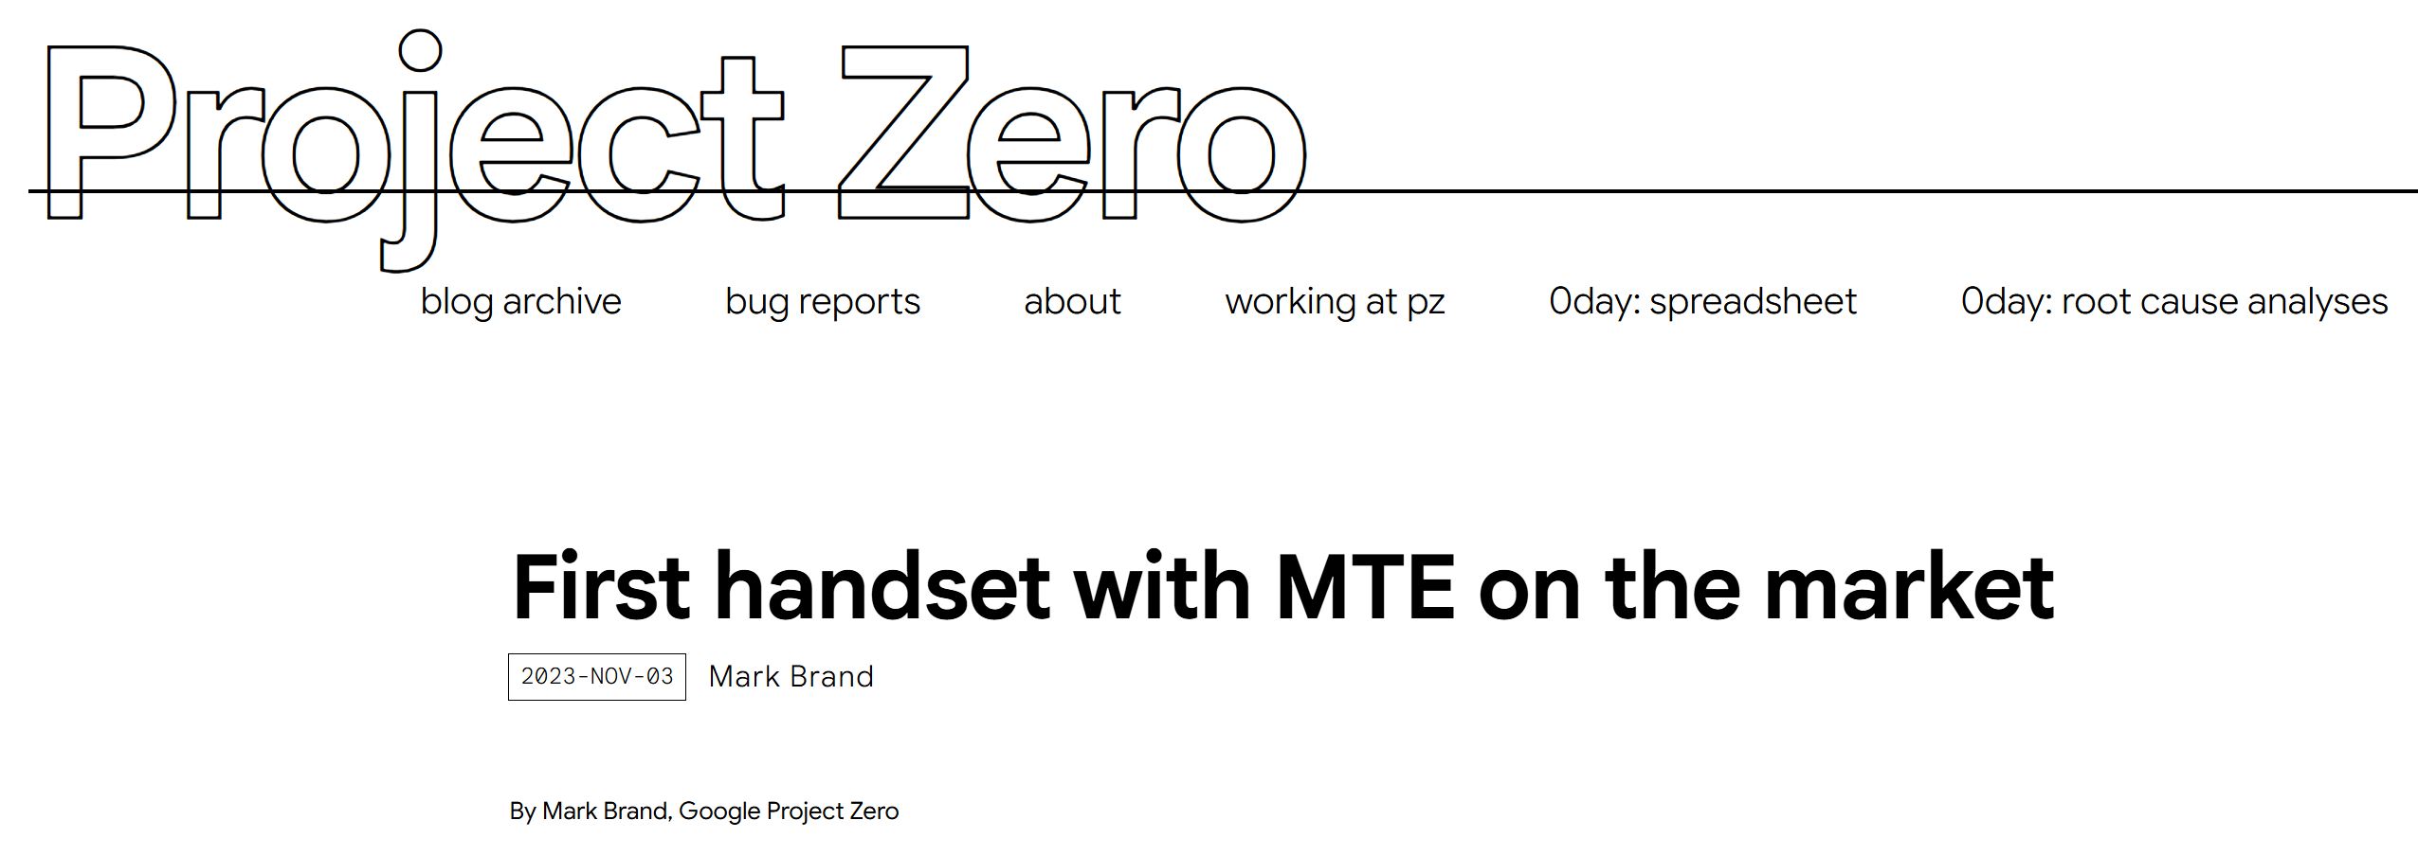
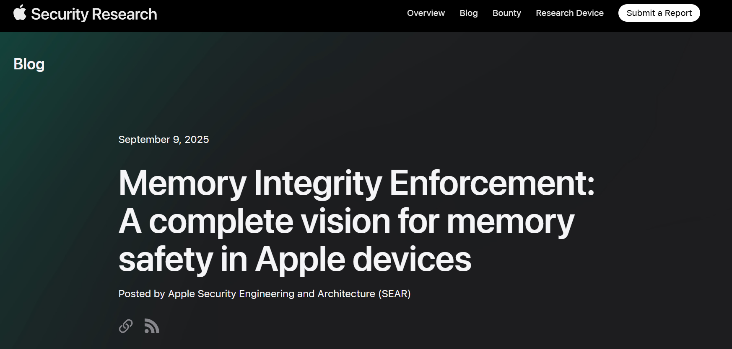


The Industry Is Embracing Memory Tagging

Slide 4




NanoTag: Byte-Granular Overflow Detection
Memory tagging is becoming an industry-backed deployment path for memory safety.
Memory tagging’s coarse granularity results in many* missed memory safety bugs.
*: ~25% in NIST Juliet Test Suite.
This motivates NanoTag,
a system to pinpoint memory safety bugs at byte granularity,
on real memory tagging hardware.
NanoTag achieves high bug-detection capability with low run-time overhead.

Slide 5


What is Memory Tagging Extension (MTE)?
MTE
Pointer (Tagged)
MTE
Buffer Overflow
Memory (Tagged)

Slide 6
MTE’s Limitation: Coarse Granularity
Pointer (Tagged)
Buffer Overflow
Buffer overflow MTE ignores becomes exploitable!
MTE fails to pinpoint subtle memory violations due to its coarse granularity.
Memory (Tagged)

Slide 7

MTE’s Coarse Granularity Has Serious Implications
CVE-2024-12084
MTE misses ~25% of overflows due to coarse granularity.
struct buf {
// ...
int32 chain;
// ...
char sum2[16];
};
Enable sanitizers during testing:
NIST Juliet Test Suite
sums = allocate(struct buf, count);
sums = allocate(struct buf, count);
// . . .
read_buf(f, sums[i].sum2, s2length);
// . . .
~85% of memory allocations are potentially vulnerable to such overflows MTE misses.
Software sanitizer (e.g., ASan) finds the bug,
although with high run-time overhead (~2x).
Attacker: make s2length larger!
SPEC CPU 2017
MTE ignores the overflow due to coarse granularity.
s2length
s2length
MTE’s coarse granularity exposes a large surface of evading MTE checks.
sum2[16]
Buffer Overflow

Slide 8
NanoTag: Byte-Granular Overflow Detection
How does NanoTag address the challenges of byte-granular overflow detection?
NanoTag achieves high bug-detection capability with low run-time overhead.

Slide 9
Changing Hardware to Detect Byte-Granular Overflows Is Expensive
MTE’s tag storage overhead:
S(tag)
4 bits
S(data)+S(tag)
16 bytes + 4 bits
3%
To support byte-granular detection:
S(tag)
4 bits
S(data)+S(tag)
1 byte + 4 bits
33.33%
1/3 of physical memory to store only the tags.
Memory
Tags

Slide 10

NanoTag Combines Hardware & Software
Hardware MTE Checks
Software Sanitizer Checks
Additional metadata stored inline
=> “zero” memory overhead
NanoTag uses software checks when hardware checks are insufficient.
Memory
Tags
Tags

Slide 11


However, Software Checks Are Slow …
Hardware checks are fast.
Software sanitizer checks sometimes incur a large run-time overhead.
Memory
Tags

Slide 12


Explicit Detection-Performance Tradeoff
Detection
Performance
NanoTag
Signal
(e.g., coverage)
Fuzzer
Interesting input: sanitizer accuracy ⬆️
Repetitive input: fuzzing throughput ⬆️
Memory
Tags
NanoTag introduces an explicit detection-performance tradeoff via controllable knobs.

Slide 13
NanoTag: Byte-Granular Overflow Detection
NanoTag achieves high bug-detection capability with low run-time overhead.

Slide 14
NanoTag Balances Detection & Performance
Bug Detection Capability
NIST Juliet Test Suite
100%
Ideal
98%
NanoTag
ASan
Valgrind
75%
MTE
NanoTag provides bug-detection capability similar to ASan, with performance overhead similar to MTE.
50%
Closed-source binary, real-world applications, and fuzzing: more results in the paper!
25%
GWP-ASan
0%
1x
1.1x
2x
4x
8x
10x
Performance Overhead
SPEC CPU 2017

Slide 15

NanoTag: Byte-Granular Overflow Detection
Memory Tagging Extension (MTE)’s coarse granularity results in missed bugs during in-house testing (e.g., fuzzing).
Hardware + Software
NanoTag
Explicit Detection-Performance Tradeoff
More in the paper!
Bug Detection Capability: Near ASan
Run-Time Overhead: Near MTE
NanoTag Artifacts
Mingkai Li, Columbia University
mailto: mingkai.li@columbia.edu
website: mingkai-li.github.io

